Slide 1
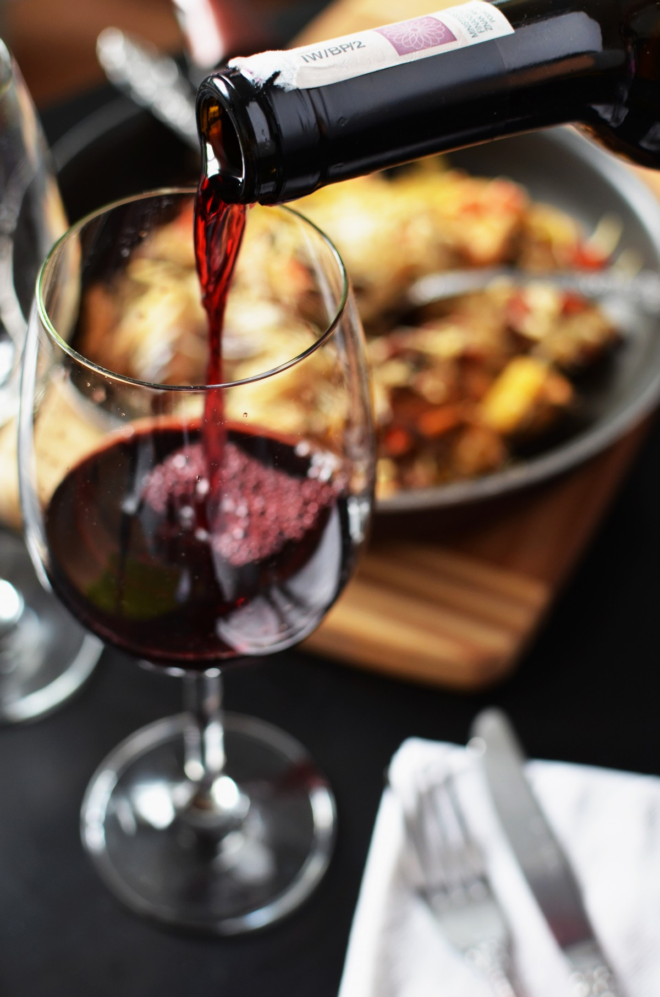
QUALITY OF RED WINE REGRESSION PROJECT
PRESENTED BY:
T GANESH

Slide 2
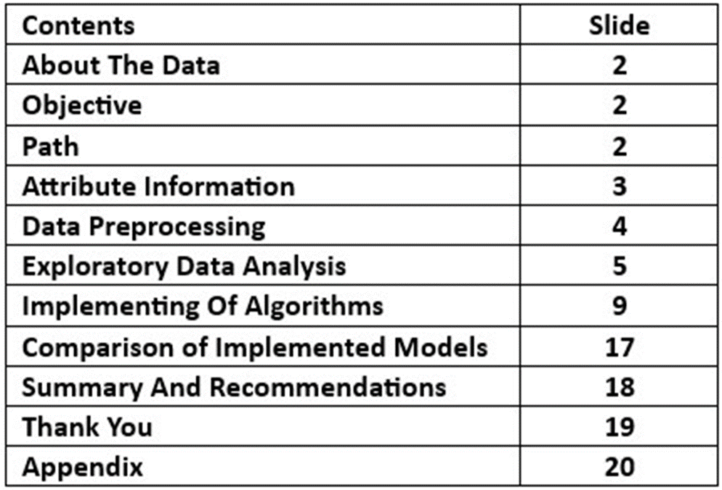
INDEX

Slide 3
ABOUT THE DATA
BACKGROUND:
This regression dataset consists of various chemical and physical attributes of wines(e.g. acidity levels, sulfur dioxide content, alcohol percentage) along with a quality score ranging from 0 to 10, derived from sensory evaluations.
OBJECTIVE:
The objective is likely to develop a predictive model that estimates the quality of wine based on these attributes, aiding in understanding the relationship between wine composition and its perceive quality for potential improvements in wine making processes.
PATH:
Implementing multiple machine learning models to fit the best model for the dataset.

Slide 4
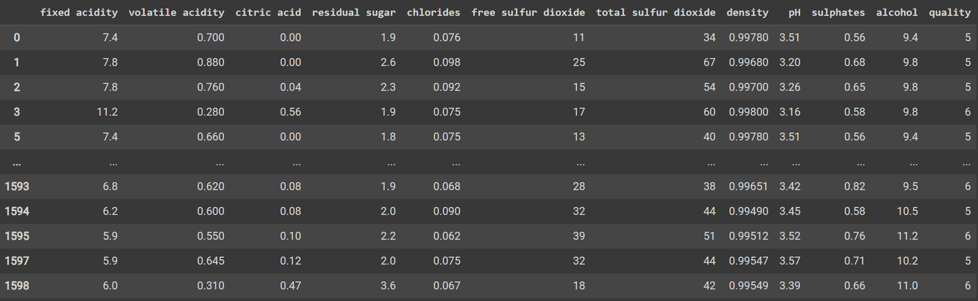
DATASET

Slide 5
DATA CLEANING
DATA CLEANING:
The data is in the correct format.
HANDLING WITH THE MISSING AND DUPLICATE VALUES:
The dataset does not contain any missing or duplicate values.
DUMMY VARIABLE ENCODING:
The dataset doesn’t contain any categorical columns and are in correct format.

Slide 6
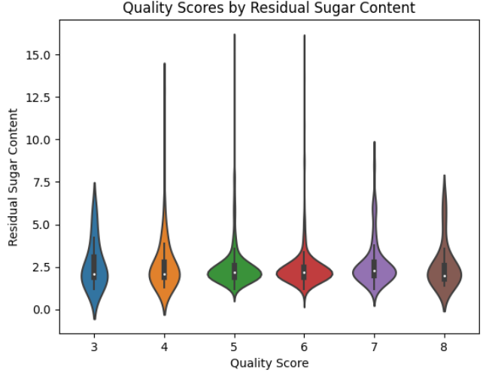
EDA

Slide 7
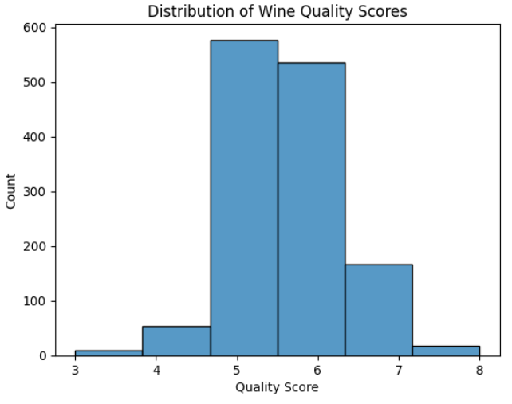
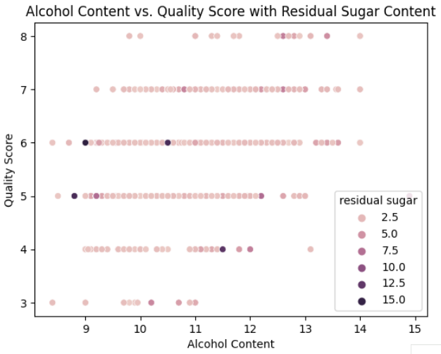

Slide 8
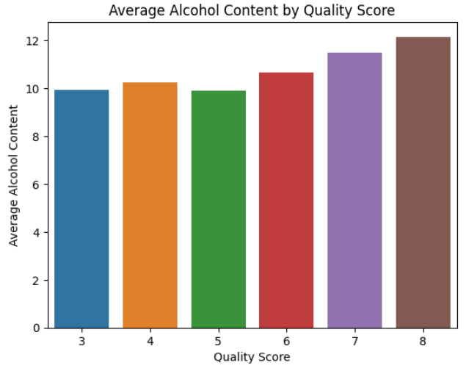
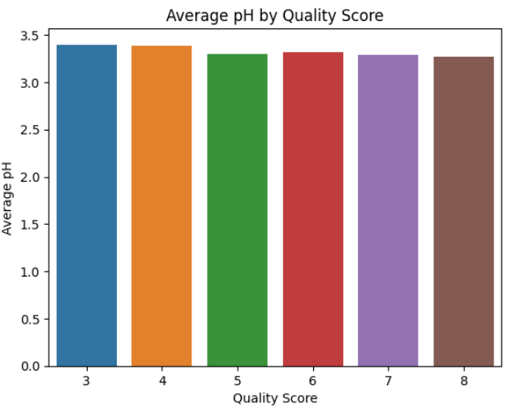

Slide 9
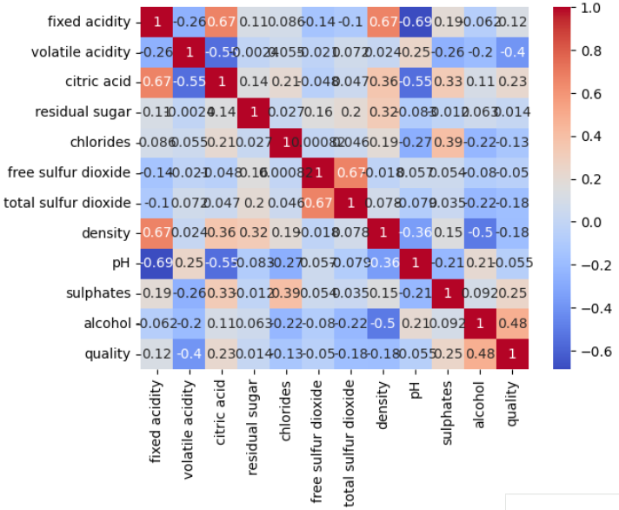

Slide 10
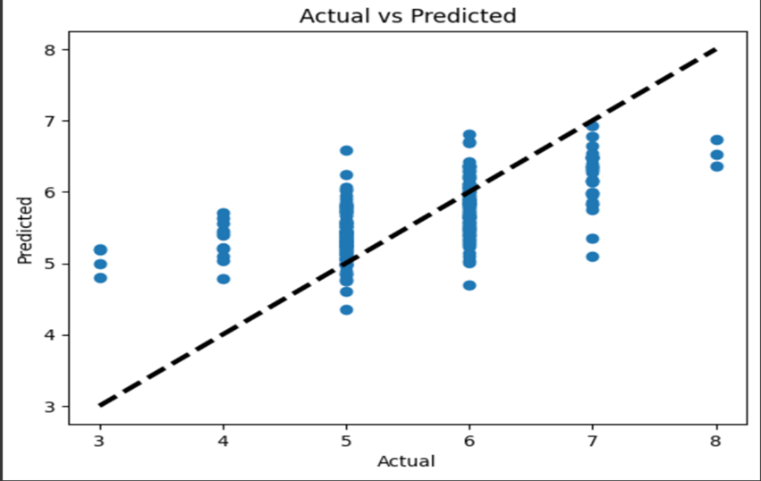
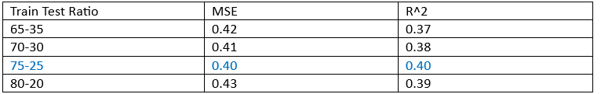
LINEAR REGRESSION

Slide 11
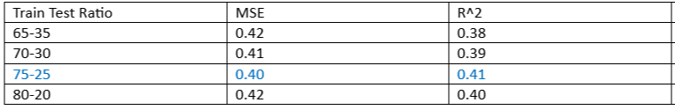
SUPPORT VECTOR MACHINE

Slide 12
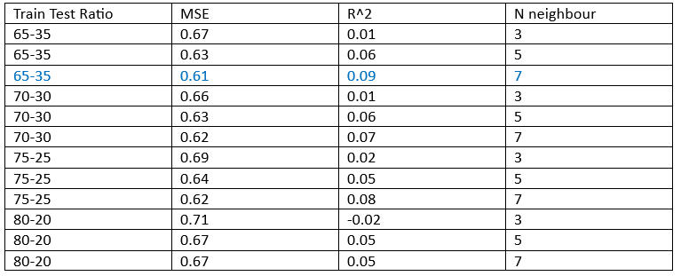
K-NEAREST NEIGHBORS

Slide 13
DECISION TREE

Slide 14
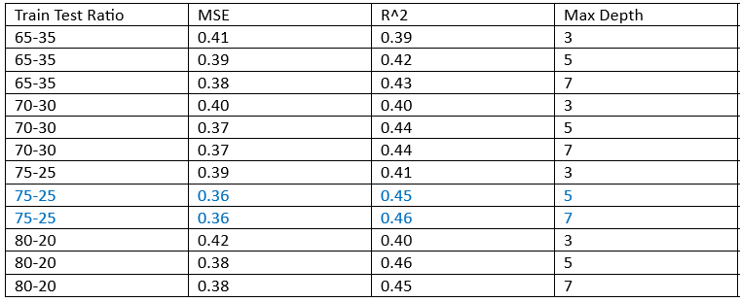
RANDOM FOREST

Slide 15
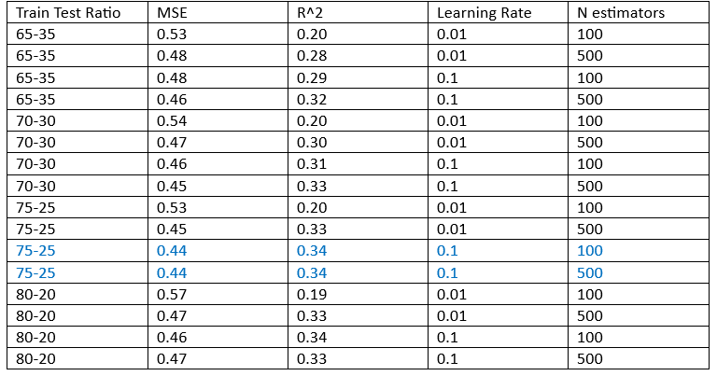
ADA BOOST

Slide 16
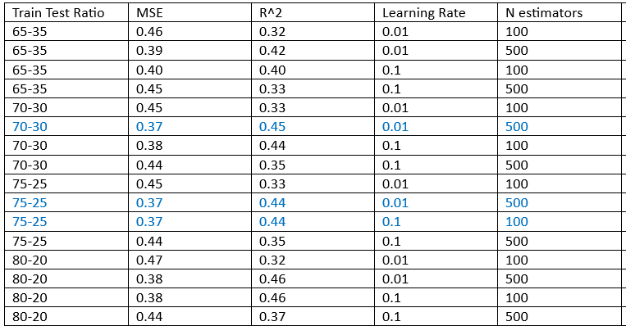
GRADIENT BOOST

Slide 17
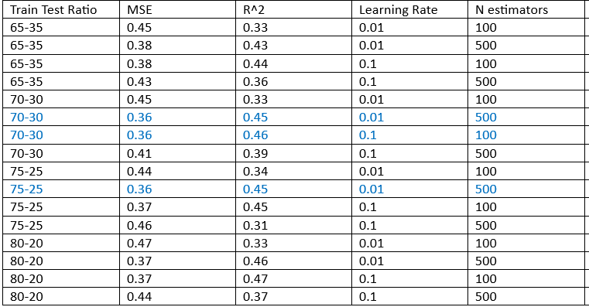
XG BOOST

Slide 18
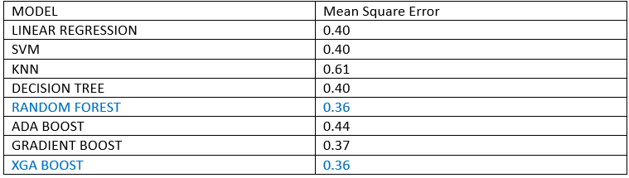
COMPARISON OF IMPLEMENTED MODELS

Slide 19
SUMMARY AND RECOMMENDATIONS
For the Quality of Red Wine , we performed five types of machine learning algorithms Linear Regressions, SVM, KNN, Bagging, Boosting.
From all the analysis and implementations of the algorithm, we found the best result in the Random Forest and XG Boost algorithms for 75-25 train-test ratio ( parameters : Max depth =7, N estimators =1000 ) with Mean Square Error (MSE) of 0.36 which is the least error value among all the other errors.
So, here we can conclude that Random Forest and XG Boost Algorithms can be considered the best model for the give Quality of Red Wine dataset.

Slide 20
THANK YOU!!

Slide 21
APPENDIX

Slide 22
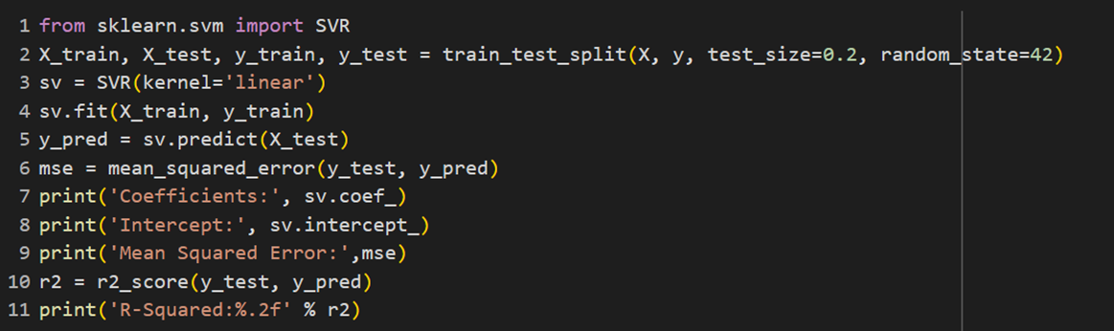
LINEAR REGRESSION

Slide 23
SUPPORT VECTOR MACHINE

Slide 24
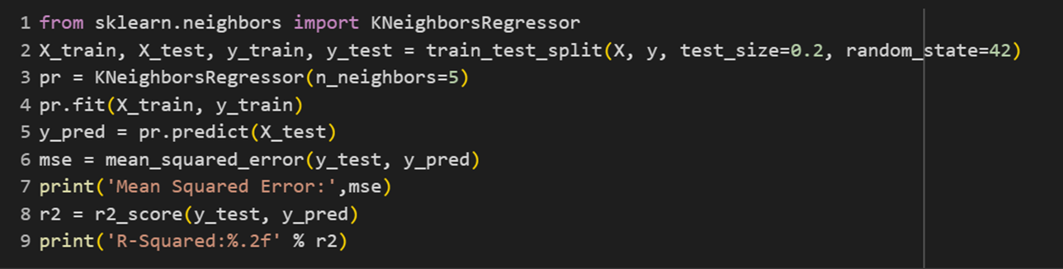
K-NEAREST NEIGHBORS

Slide 25
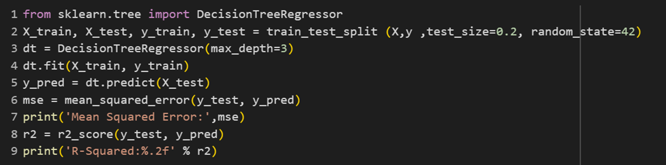
DECISION TREE

Slide 26
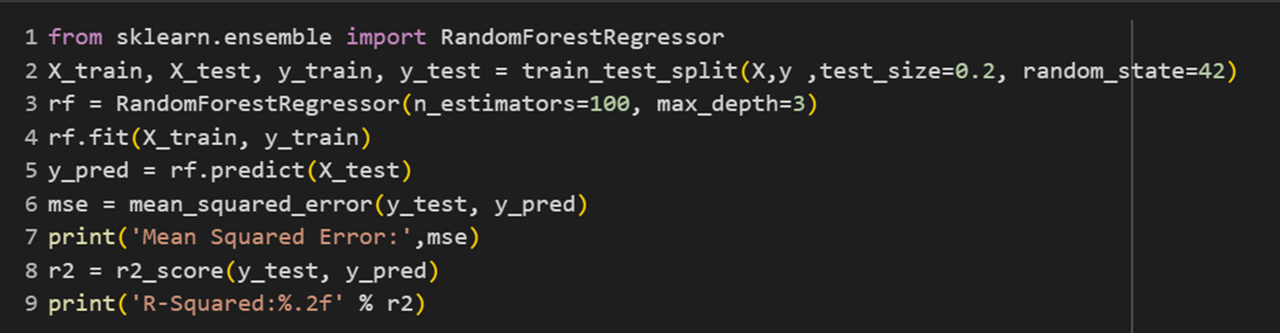
RANDOM FOREST

Slide 27
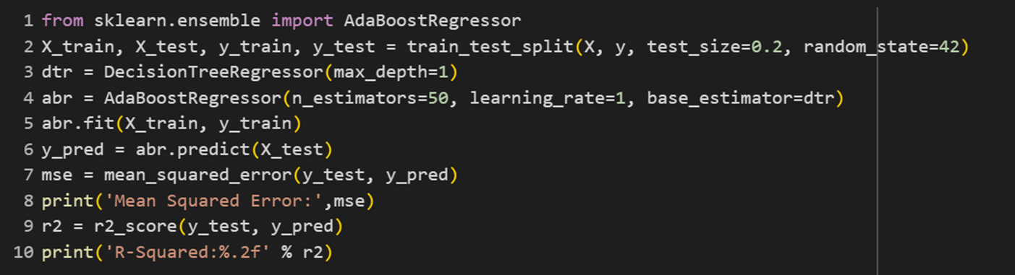
ADA BOOST

Slide 28
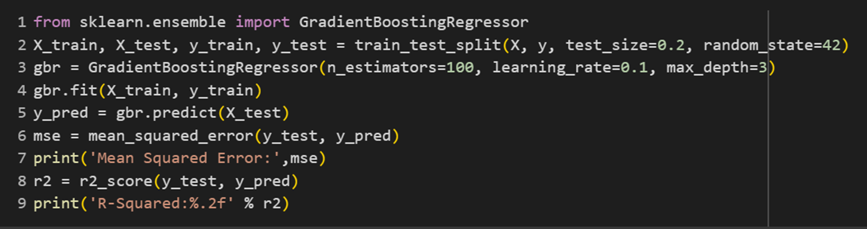
GRADIENT BOOST

Slide 29
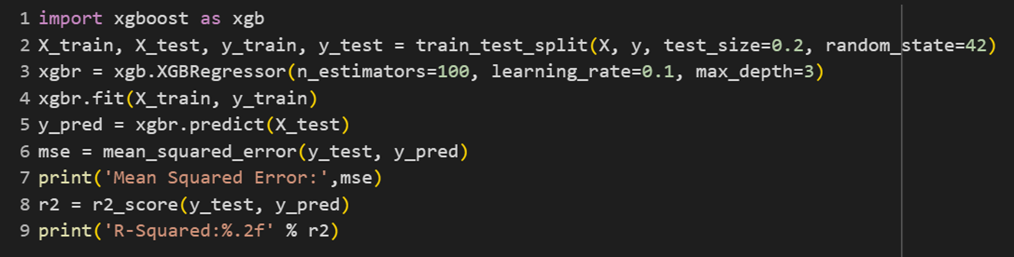
XG BOOST

